Slide 1
Kaiser Permanente – Lambda Reference Architecture
December 18th 2019

Slide 2

Agenda
01
Lambda architecture - overview
02
Patterns of Lambda architecture
03
Azure Lambda architecture
04
Azure Lambda architecture with Change Feed
05
Potential use case in Healthcare
06
Key takeaways
07
Appendix

Slide 3
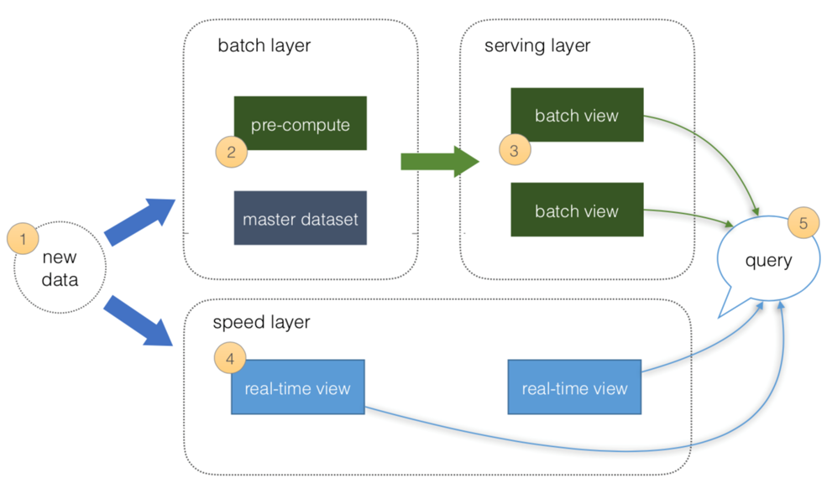
Lambda Architecture
Lambda Architecture -
Handles massive quantities of data by leveraging both batch and stream-processing
Mitigates latencies of batch processing
Comprised of a data model (master dataset) with an append-only, immutable data source and three layers
Batch layer - manages the master dataset and pre-compute batch views
Speed layer - processes data streams in real-time. It fills the "gap" caused by the batch layer
Serving layer – quickly responds to consumer requests
Lambda Architecture Principles –
It is dependent on underlying data principles of append-only, immutable, and atomic
It focuses on balancing latency, throughput, and fault-tolerance
It correlates with the growth of big data and real-time analytics
It helps to mitigate the latencies of batch processing
Advantages of Lambda Architecture
Fault tolerant to machines failure and human mistakes
The batch and real-time views can be always recomputed from the master dataset
Low latency of reads and updates
Scalability - all layers can be scaled independently

Slide 4
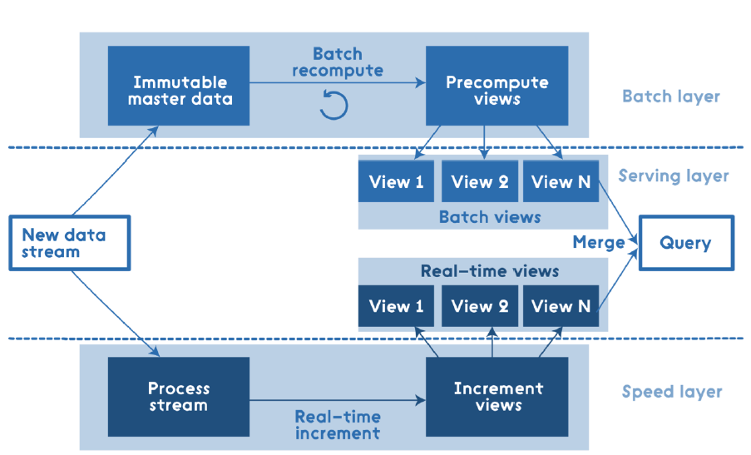
Patterns of Lambda Architecture
This architecture has three layers – batch layer, speed layer and serving layer
All data entering the system is dispatched to both the batch layer and the speed layer for processing
The batch layer manages the master dataset, an immutable, append-only set of raw data and pre-computes the batch views
The speed layer compensates for the high latency of updates to the serving layer and provides real-time views
The serving layer combines batch view and real-time views to give results in real-time for any ad-hoc query over all data
Bottom line: lambda architecture is query=function(over all data)

Slide 5


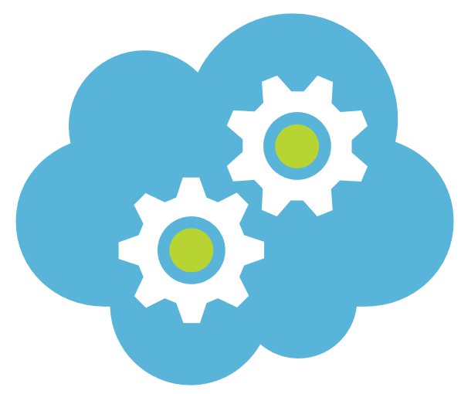
Azure Lambda Architecture
The Azure Lambda Architecture is identical to the reference Lambda architecture
Data Source(s)
Batch Layer
Serving Layer
Encounter
Pre- compute Data
Batch View
Data Ingestion Service
Lab
Master data
Batch View
Decision Layer
Pharmacy
Speed Layer
Membership
Real-time Data
Real-time View
Billing
Advantages of Azure Lambda Architecture
Security – no compromise on the data security ; provides security for both data in rest and flight
Flexibility – You can use open source capabilities such as spark , hive , Sqoop etc. on Azure
Supportability – supports heterogeneous platforms based devices and various protocols & industry standards
Reliability – SLA based guaranteed performance

Slide 6
Azure Lambda Architecture with Change Feed
Data Source(s)
Batch Layer
Serving Layer
It is an evolution of the original Lambda Architecture.
The data ingestion service is built for high volume and high frequency scenarios.
All data is pushed only into Azure Cosmos DB
Cosmos DB serves as the master data (immutable, append-only) repository. Also:
Built for high velocity and high volume data operations
Change feed is enabled by default
Automatic Change Feed generation is guaranteed
The speed layer reads the Change Feed to create Real-time views
The Decision Layer minimizes query logic complexity
This architecture requires minimum custom development
Encounter
Pre- compute Data
Batch View
Lab
Data Ingestion Service
Master data
(Cosmos DB)
Batch View
Pharmacy
Change Feed
Speed Layer
Decision Layer
Membership
Billing
Real-time Data
Real-time View
Cosmos DB
Service guarantees - high availability, minimal latency, and comprehensive SLAs
Provides automatic data maneuvering through Change Feed
Change Feed
Automatically enabled in any Cosmos DB database account
Doesn’t need any additional configuration to start working

Slide 7
Potential Healthcare use cases
Electronic Health Records - keep track of each patient’s health chart and their medical reports, thereby reducing the need for duplicate tests and the associated cost.
Real-time Alerts - Help doctors analyze patient’s health conditions in real-time to and make quick course correction, when required. Clinical support decision can offer prescription(s) after analyzing a patient’s medical data.
Track devices and vehicles in real-time – track emergency transportation vehicles to make preparations to provide most expeditious care. Could be a difference between life and death.
Evidence Based Medicine - provide doctors with the evidence of a patient’s record and compares the symptoms to a larger database of the patient; thereby enabling accurate, faster, and more efficient treatments. It helps easy decision making and better patient care.
Fraud Detection - Every data is unique and it is essential to maintain the integrity of data along with its security. It helps in the billing, personal identity, and patient records. Providers can use real-time data analytics to prevent fraudulent insurance claims.
Public Sentiment Analysis - It can help companies to be social media savvy and react quickly to public sentiment.
Business Benefits
React in real-time to the changing business / market scenarios
Informed decisions , ensure high level of services uptime and hence the good will.
Ad-hoc or exploratory data discovery for true value based payment models
Critical decision making in real-time such as, encounters, EMS, labs, benefits, billings, memberships

Slide 8

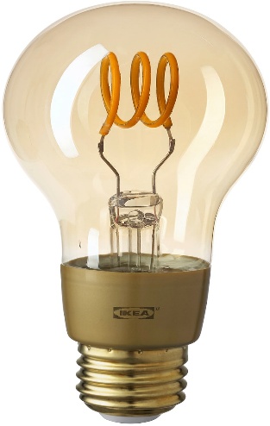
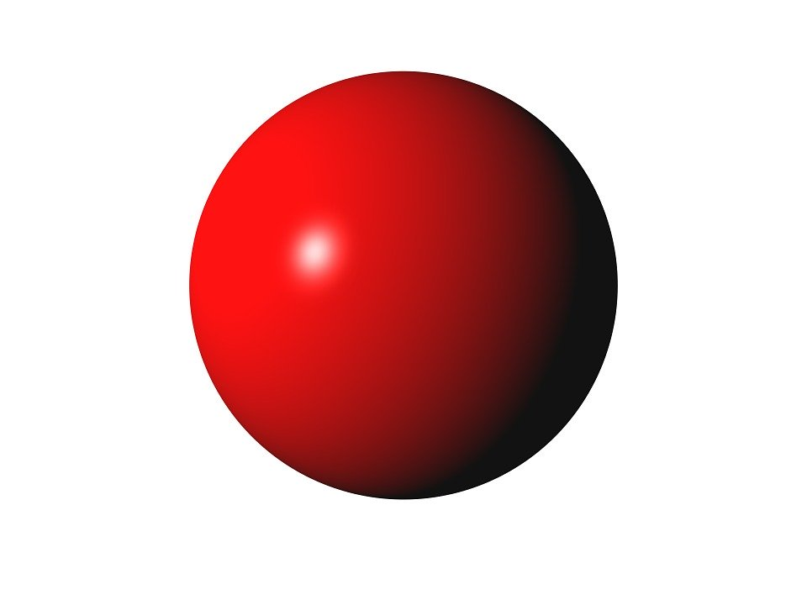
Key Takeaway
Lambda architecture is a pattern that can be implemented using many different technologies, languages and platforms
Best suited for ad-hoc queries where up to the last second information is required
Focuses on balancing latency, throughput, and fault-tolerance
Azure Lambda Architecture with Change Feed simplifies the implementation – eliminates the multicast issues
One size does not fit all - processes and tools should be selected based on the use case
Architectures, such as Delta Architecture, tackle the batch latency issues by writing batch and streaming data into the same table. It allows a simpler architecture and quicker data ingestion to query result
Kappa architecture is suitable to provide real-time analytics

Slide 10
Appendix

Slide 11
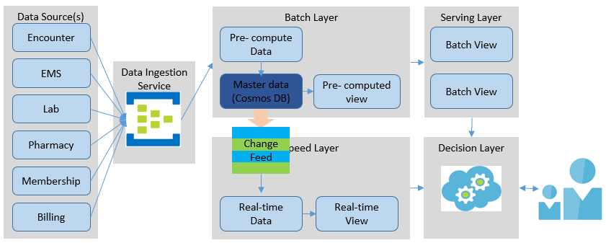
Azure Lambda Architecture with Change Feed – Detailed I
Data Sources: There can be various source systems which send data at different times, different time intervals and different velocity. Some can send data continuously (streaming data) while others can send only send once a day (batch).
Data Ingestion Service: Even though the data ingestion service is optional. Still, it is highly recommended to build the resiliency, reliability, and availability of the service. For the data ingestion service, the Azure Event Hubs is recommended for the following reasons: it has multiple (up to 10) endpoints without accruing any additional cost and it is built for high volume, high frequency events. Event Hubs Dedicated can ingest up to 2 million events/second. The SLA are guaranteed.
Batch Layer: Batch layer - manages the master dataset and pre-computed batch views. The focus of this layer to perfect the accuracy by processing all available data. This layer can recompute the batch views when needed. This layer hosts master dataset, an immutable, append-only set of raw data. Azure Cosmos DB serves as the master repository. The event data lands here first. As soon as the data is received, it is stored in the master dataset.
It is built for high velocity and high volume data operations. The Change feed event generation is enabled by default, which is guaranteed. In addition, each change to an item appears exactly once in the change feed and the change feed is sorted by the order of modification.

Slide 12
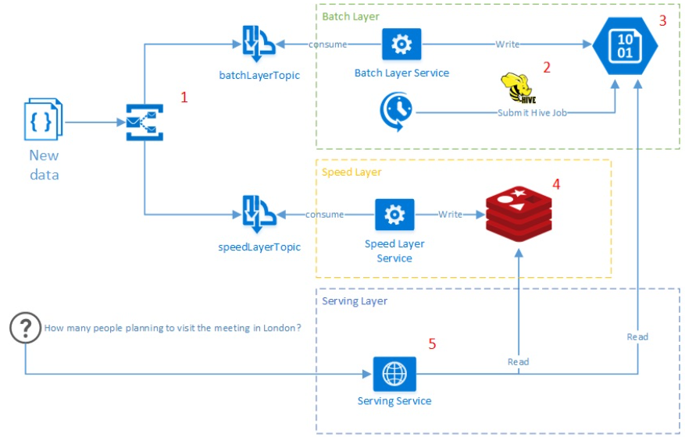
Lambda Architecture on Azure Platform
Infrastructure
Azure Service Bus - message broker which guarantees reliable message delivery to both batch and speed layer.
Service Fabrik - responsible for publishing services on Azure instances and scaling
ARM templates - infrastructure for deployment the Meetup Analytics system to the Azure cloud
Layers
Batch Layer
HDInsight Blob Storage - distributed file system (Hadoop), represents master dataset of the Meetup Analytics
Hive - allows run Hadoop job and perform intensive aggregations against a data in HDInsight Blob Storage using SQL-like syntax
Speed Layer
Redis - in-memory, key-value, NoSQL data storage with fast read and write operations
Serving Layer
Represented by simple REST service which publicly available for user's requests

Slide 13
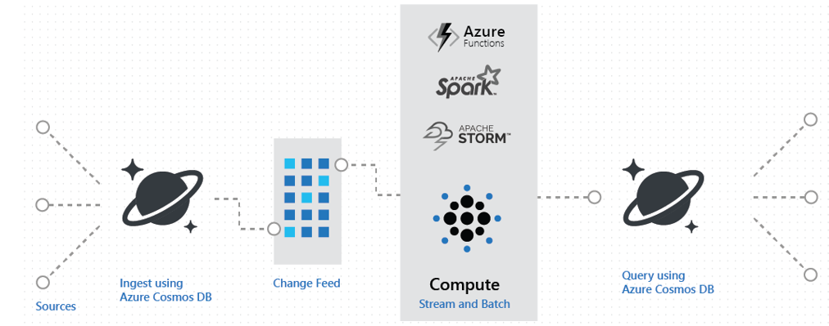
Lambda Architecture using Azure Cosmos DB via change feed
Scenarios
You can track encounters such as all the changes to a patient's profile, preferences, or their location and trigger certain actions, e.g., sending alerts, review latest information, alter treatments, etc.
Use change feed to implement real-time updates.

Slide 14
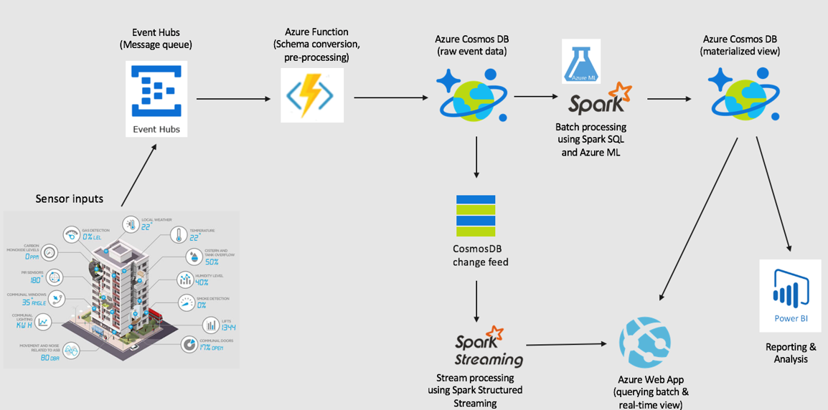
Streaming at scale using Lambda Architecture on Azure Platform

Slide 15
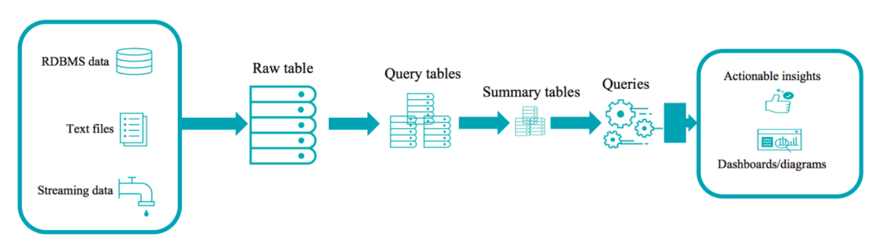

Delta Architecture
A continuous data flow model to unify batch and streaming
Raw table
(Bronze)
Query tables
(Silver)
Summary tables
(Gold)
Data from disparate data sources is collected into a raw table (also known as "bronze" tables at Databricks).
A Raw table is then parsed into query tables (also known as "silver" tables at Databricks). They may be joined with dimension tables.
Summary tables (also known as "gold" tables at Databricks) are business level aggregates often used for reporting and dashboarding. This would include aggregations such as daily active website users.
The end outputs are actionable insights, dashboards and reports of business metrics.

Slide 16
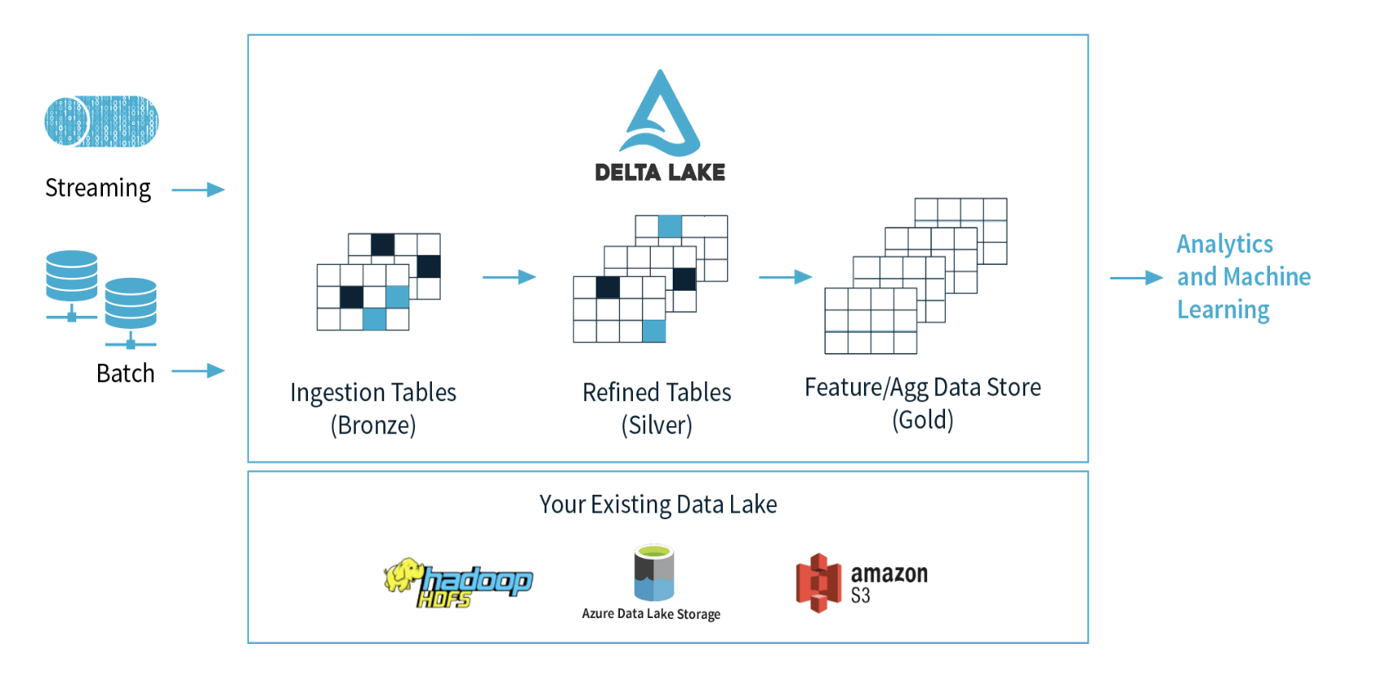
Delta Architecture Benefits
Open & Extensible
Delta Lake is an open source project with the Linux Foundation. Data is stored in the open Apache Parquet format, allowing data to be read by any compatible reader. APIs are open and compatible with Apache Spark™.
Data Reliability
Delta Lake adds a storage layer to data lakes to manage data quality, ensuring data lakes contain only high quality data.
Manage Data Lifecycle
Handle changing records and evolving schemas as business requirements change.
Existing Data Lake

Slide 17
Work in Progress

Slide 18
Lambda Architecture
Lambda architecture handles massive quantities of data by leveraging both batch and stream-processing
Mitigates latencies of map-reduce
Comprised of a data model (master dataset) with an append-only, immutable data source
Has three layers: batch layer (accuracy and completeness), speed (or real-time) layer, and a serving layer for responding to queries
Batch layer - has two basic functions: manage the master dataset and pre-compute batch views. It aims to perfect the accuracy by processing all available data
Speed layer - processes data streams in real-time, without fix-ups or completeness to minimize the latency. It fills the "gap" caused by the batch layer. May not be as accurate or complete as the batch layer and can be replaced when the batch layer's views for the same data become available
Serving layer - Output from the batch and speed layers are stored in the serving layer, which responds to consumer requests
Criticism - Inherent complexity and its limiting influence. The batch and streaming sides each require a different code base that must be maintained and kept in sync
Alternative - A flexible streaming framework such as Apache Samza could provide some of the same benefits without the latency; a streaming framework could allow for collecting and processing arbitrarily large windows of data, accommodate blocking, and handle state.
Advantages of Lambda Architecture
Robustness and fault tolerance - the system is tolerant to machines failure and human mistakes such as data corruption. The batch and real-time views can be always recomputed from the master dataset.
Low latency read and update - the Lambda Architecture allows to achieve both without compromising robustness.
Scalability - all layers can be scaled independently.
Generalization - Lambda Architecture can be used across a large number of different applications. - Wikipedia

Slide 19
Patterns of Lambda Architecture
This architecture has three layers – batch layer, speed layer and serving layer
All data entering the system is dispatched to both the batch layer and the speed layer for processing
The batch layer has two functions:
Manage the master dataset, an immutable, append-only set of raw data
Pre-compute the batch views
The speed layer compensates for the high latency of updates to the serving layer and deals with recent data only, providing real-time views
The serving layer combines batch view and real-time views to give results in real-time for any ad-hoc query over all data
Bottom line: lambda architecture is query=function(over all data)

Slide 20
Azure Lambda Architecture
The Azure Lambda Architecture is identical to the reference Lambda architecture
Data Source(s)
Batch Layer
Serving Layer
Encounter
Pre- compute Data
Batch View
Data Ingestion Service
Lab
Master data
Batch View
Decision Layer
Pharmacy
Speed Layer
Membership
Real-time Data
Real-time View
Billing
Advantages of Azure Lambda Architecture
Lower complexity – no need to deliver data to multiple endpoints
Security – no compromise on the data security ; provides security for both data in rest and flight
Flexibility – You have flexibility to use open source capabilities such as spark , hive , Sqoop etc. on Azure and continue leveraging your hard earned skill
Supportability – supports heterogeneous platforms based devices and various protocols & industry standards
Adaptability – when a particular protocol is not supported , you have freedom to have protocol adapter to standardize to a particular protocol
Optimized cost – pay as you go
Reliability – Azure SLAs are defined at services levels and transparent
Supports all communication patterns – Telemetry , Inquiries , Commands & Notifications

Slide 21
Azure Lambda Architecture with Change Feed
Data Source(s)
Batch Layer
Serving Layer
The Azure Lambda Architecture with Change Feed is an evolution of the original Lambda Architecture. It has evolved in the following ways:
The data ingestion service uses Azure Event Hubs, has multiple (up to 10) endpoints and built for high volume, high frequency scenarios. Event Hubs Dedicated can ingest up to 2 million events/second.
All data is pushed only into Azure Cosmos DB. Eliminates multi-casting issues.
Cosmos DB serves as the master data (immutable, append-only) repository. Cosmos DB is selected based on the following factors:
Well-suited for high velocity and high volume data operations
Change feed is enabled by default for all Azure Cosmos accounts
Each change to an item appears exactly once in the change feed
The change feed is sorted by the order of modification
As soon as the data is merged into the master data (Cosmos DB), Change feed events generated.
The speed layer utilizes HDInsight (Apache Spark) to read the Azure Cosmos DB change feed to create Real-time views.
The Decision Layer analyzes the query and determines whether to utilize Batch view(s), or Real-time view(s), or merging of the two. It relieves the consumer of the query logic complexity
This architecture utilizes mature Azure services and platform with very little custom development – significantly shorter time to value!
Encounter
Pre- compute Data
Batch View
Lab
Data Ingestion Service
Master data
(Cosmos DB)
Batch View
Pharmacy
Change Feed
Speed Layer
Decision Layer
Membership
Billing
Real-time Data
Real-time View
Cosmos DB
Service guarantees - high availability, minimal latency, and comprehensive SLAs
Adapts to all sizes of databases through elastic throughput
Provides automatic data maneuvering through Change Feed
Integrates natively with data processing engines -> Apache Spark
Integrates natively with serverless components.
Change Feed
Automatically enabled in any Cosmos DB database account.
Doesn’t need any additional configuration to start working.
Uses the existing allocated request units for processing events.
Executed on insert and update operations. Delete support can be implemented with a flag.
Can be used as a streaming layer without requiring another component.

Slide 22

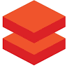
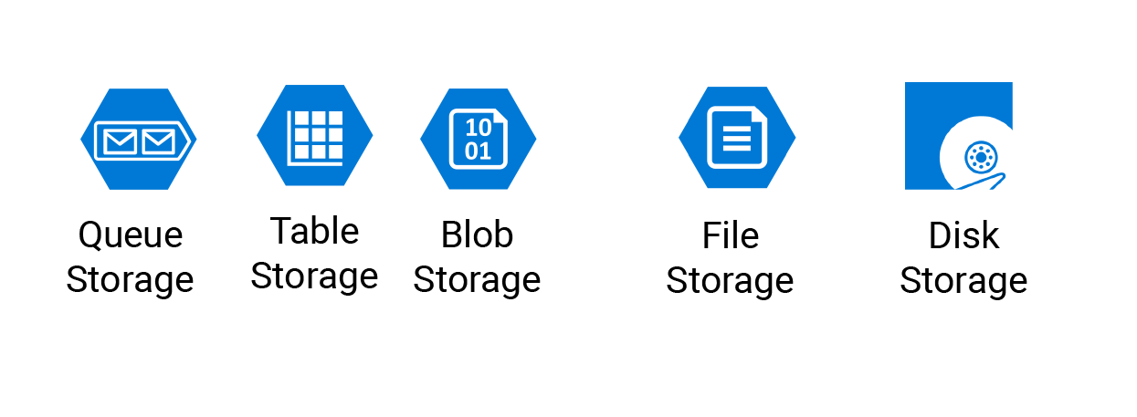






Azure Lambda Architecture with Change Feed
Azure platform products and services used
Data Source(s)
Batch Layer
Speed Layer
Encounter
EMS
HDInsight/Databricks
Blob/Table storage / Cosmos DB Container
Decision Layer
Lab
Cosmos DB
Databricks
Pharmacy
Speed Layer
Event Hubs
Scala
Membership
Real-time View
Billing
Layer | Description | Azure Services used
Batch layer | Manages master dataset, an immutable, append-only set of raw data Pre-compute the batch views | Azure HDInsight or Azure Spark, and Azure Cosmos DB for the master dataset
Speed layer | Most recent data only and provides real-time views Compensates for the high latency of updates to the serving layer | Azure Spark on HDInsight
Serving layer | Persists pre-computed batch view for fast responses | Azure Blob or Table storage or Cosmos DB container
Decision layer | Determines whether to use Batch view(s), or Real-time view(s), or merging of the two. Minimizes query logic complexity | Uses Python/Scala on HDInsight/Databricks platform

Slide 23
Potential Healthcare use cases
Electronic Health Records - keep track of each patient’s health chart and their medical reports, thereby reducing the need for duplicate tests and the associated cost.
Real-time Alerts - Help doctors analyze patient’s health conditions in real-time to and make quick course correction, when required. Clinical support decision can offer prescription(s) after analyzing a patient’s medical data.
Getting ahead of Patient Deterioration - Can help providers react quickly to changes in a patient’s vitals, and may be able to identify an upcoming deterioration before symptoms clearly manifest themselves.
Prevent suicide and patient self-harm- Early identification of individuals likely to cause harm to themselves can ensure that these patients receive the mental healthcare they need to avoid serious events, including suicide.
Track in Real-time devices and vehicles – track emergency transportation vehicles to make preparations to provide most expeditious care. Could be a difference between life and death.
Evidence Based Medicine - provide doctors with the evidence of a patient’s record and compares the symptoms to a larger database of the patient; thereby enabling accurate, faster, and more efficient treatments. It helps easy decision making and better patient care.
Hospital Re-admissions - helps identify at-risk patients based on their medical reports, records, and laboratory reports and offer reduced readmission charges. This enables a patient to focus on the medical care and not so much on the readmission charges.
Fraud Detection - Every data is unique and it is essential to maintain the integrity of data along with its security. It helps in the billing, personal identity, and patient records. The insurance company can use real-time data analytics to prevent fraudulent insurance claims. Predictive analysis plays a vital role in fraud detection.
Public Sentiment Analysis - It helps companies to be social media savvy and react quickly to devise new policies, procedures and approaches.
Situation aware Planning, Care and Cost – Events, such as, natural disasters, adverse weather conditions, could require different resource planning, care type(s) and costs, e.g., no/lower charges to build goodwill and public support.
Forestalling appointment no-shows – unexpected gaps in appointments can have financial impact and work schedule plans. Real-time analytics can predict patients likely to miss the appoint. Improves provider satisfaction, cut down on revenue losses, and offer open slots to other patients, and increase speedy access to care.
Effective Management of Supply Chain - Significant opportunities for healthcare organizations to trim unnecessary spending and improve efficiency. Real-time analytics can reduce variation and gain more actionable insights into ordering patterns and supply utilization.
Business Benefits
React in real-time to the changing business / market scenarios
Predict from human behaviors to machines / devices lifetime patterns and make proactive informed decisions
informed decisions , ensure high level of services uptime and hence the good will.
Ad-hoc or exploratory data discovery for true value based payment models
Critical decision making in real-time such as, encounters, EMR, labs, benefits, billings, memberships

Slide 24
Additional use case for Lambda Architecture
Update a cache, update a search index, or update a data warehouse with data stored in Azure Cosmos DB.
Implement an application-level data tiering and archival, for example, store "hot data" in Azure Cosmos DB and age out "cold data" to other storage systems, for example, Azure Blob Storage.
Perform zero down-time migrations to another Azure Cosmos account or another Azure Cosmos container with a different logical partition key.
Implement lambda architecture using Azure Cosmos DB, where Azure Cosmos DB supports both real-time, batch and query serving layers, thus enabling lambda architecture with low TCO.
Receive and store event data from devices, sensors, infrastructure and applications, and process these events in real time, for example, using Spark. The following image shows how you can implement lambda architecture using Azure Cosmos DB via change feed:
Within your serverless web or mobile apps, you can track events such as all the changes to your customer's profile, preferences, or their location and trigger certain actions, for example, sending push notifications to their devices using Azure Functions.
If you're using Azure Cosmos DB to build a game, you can, for example, use change feed to implement real-time leaderboards based on scores from completed games.

Slide 25
Azure best practices
Utilize Azure Advisor as much as possible
Billing should be properly managed, e.g., properly design tag schema and use it effectively
Resources should be created at beginning and discarded after each use, otherwise they keep accruing expenses
Security is a big challenge and should be diligently practiced. New security models, such as adaptive security models should be considered
Every architecture must address: scalability, availability, resiliency, management, and security
designed for self-healing
Make all things redundant
minimize coordination
Design to scale out
Partition around limits
Design operations
Use the right data store for the right job
Build for the need of business

Slide 26
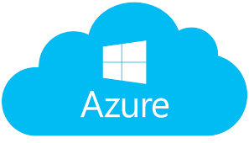
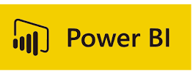
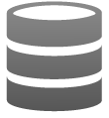

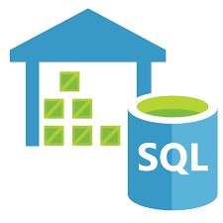
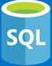
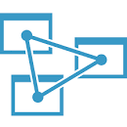













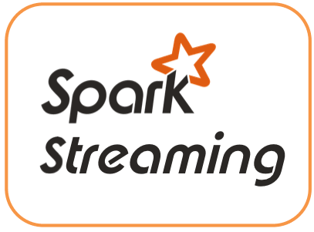












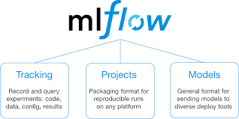







Azure Data Lake - Reference Architecture
Source layer
Aggregate layer
Analyze layer
Publish layer
Data Consumption
Source Layer
VPN
Data Access
Firewall
Curated Layer
Publish Layer
VPN
Azure Data Factory V2
Raw
Cleansed/
Enriched
AMI/CIS
ODBC/JDBC
Azure Databricks
Azure Databricks
PC
(VPN)
Azure SQL Data Warehouse & SQL DB
Azure Analysis Service
NMS
ADLS
Web Service
Files
ADLS
API
WMS
Event hub- Capture
Smart
Phone
Web Services
GIS
Express Route
Cosmos DB
Oracle Golden
Gate
Azure
DataBricks
Azure Functions
Azure API
APP
Downstream Data Systems
Semi-structured
Azure Event Hub
Un-structured
BizTalk
Azure Streaming Analytics
Insights/Models
Azure API
Management
Real Time Data
Azure API Management
& Logic APP
Azure ML
Databricks
ML Flow
Azure Cognitive Services
IOT
Audit balance and control
Batch
Authentication, Authorization, Accounting &
Data Protection
Secure Key Management
Orchestration
Monitoring and Administration
Azure DevOps
Near realtime
Azure Active Directory
Data Factory
Real-time
Key Vault
Azure Monitor

Slide 27
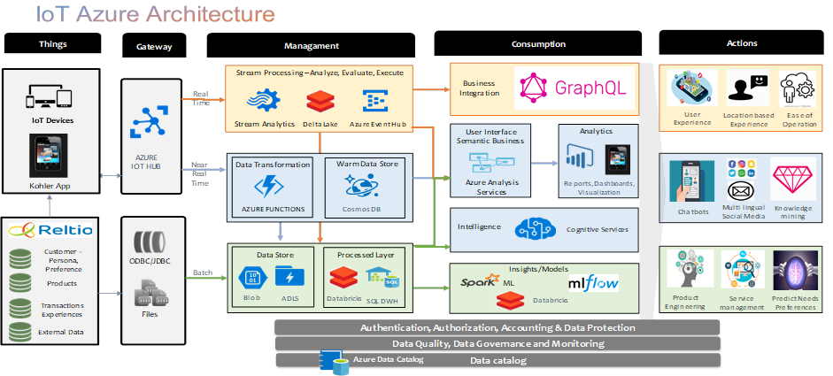
IoT Architecture

Slide 28
Data Source(s)
Batch Layer
Serving Layer
Encounter
Pre- compute Data
Batch View
EMS
Data Ingestion Service
Master data
(Cosmos DB)
Pre- computed view
Batch View
Lab
Pharmacy
Change Feed
Speed Layer
Decision Layer
Membership
Billing
Real-time Data
Real-time View

